Slide 1
Starting with Python
Wrestling with Python

Slide 2
Overview
What is Python?
How do I get hold of a copy?
The IDLE Python Environment
Python Commands
Making a Python Program

Slide 3
What is Python?
Python has been around for a while
It was invented by Guido van Rossum as a general purpose scripting language which supports a wide range of programming styles and techniques
It is named after the TV show
Of course

Slide 4
Do we need another language?
We probably don’t
But Python is very interesting for a number of reasons:
Designed to be easy to read and learn
Works on lots of systems
Is being promoted as the “native” language for the Raspberry Pi

Slide 5
What is Python?
Python is a scripting language that you can use to write programs
A scripting language is used to give commands to an interpreter that then acts on each command
This not quite the same as some programming languages which are converted into low level instructions

Slide 6
Scripting Languages
Scripting languages are slightly slower to run than compiled languages (but this doesn’t really matter)
To execute a script you run the interpreter and feed it the script it is working on
You can also feed the interpreter one line of Python at a time, which is interesting

Slide 7
Learning Python
Python is great to learn
But there are some pitfalls
Like everything else to do with computers, you would think that everything was there for the best possible reason and works in the best possible way
This is not necessarily always the case though
We just have to deal with this

Slide 8
Python Versions
Python has now reached Version 3.n
But there is a large legacy of Python code out there that is based on Version 2.n
This is not an issue for the purpose of this course, because everything we will mention runs on both versions
But you may need to remember this when looking at existing code
We are going to use Version 3.3.2

Slide 9
Getting Python
You can download Python from
http://www.python.org/download/
You just need to run the MSI installer package

Slide 10
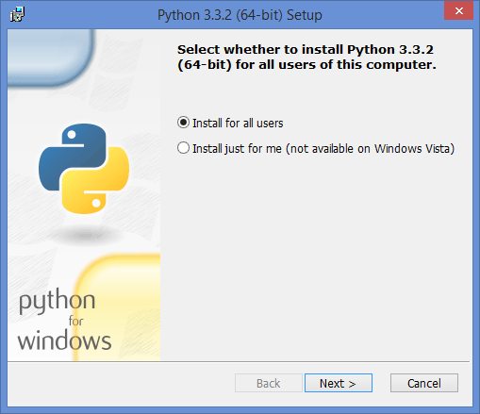
Python Installer
Install for all users and select the default destination directory

Slide 11
Running Python
When you install python you get a number of things
Python command line
IDLE Python development environment
We are going to do everything in IDLE for the time being
We can look at the other environments later

Slide 12
What we are going to do…
Get the IDLE development environment going
See how Python can obey Python statements that we enter
Experiment with entering and processing data
Discover how Python holds and converts values

